Slide 1

Deal Or Not
107753034 蔡政憲
107753022 賴以立

Slide 2

Goal
to predict whether the order will eventually be made through the information of the travel agency's order.

Slide 3

Where is Data

Slide 4


Where is Data

Slide 5
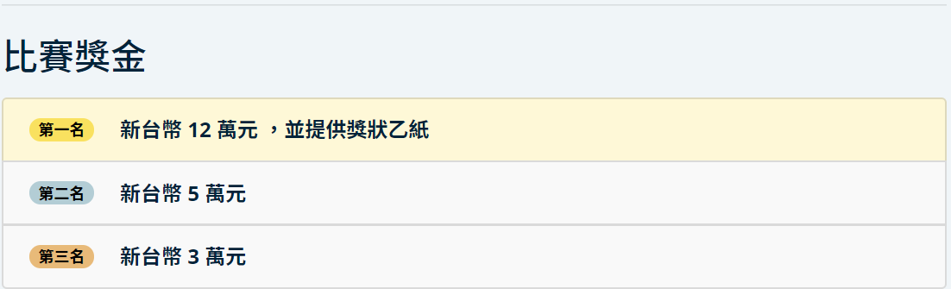
Why

Slide 6
Why
The current way of booking travel products has always been a problem.
Therefore, how to accurately predict whether the order will eventually take place while receiving the order will greatly reduce the cost of the travel agency, and at the same time allow the travel agency to provide better service.

Slide 7
Input format
airline.csv
cache_map.csv
day_schedule.csv
group.csv
order.csv

Slide 8
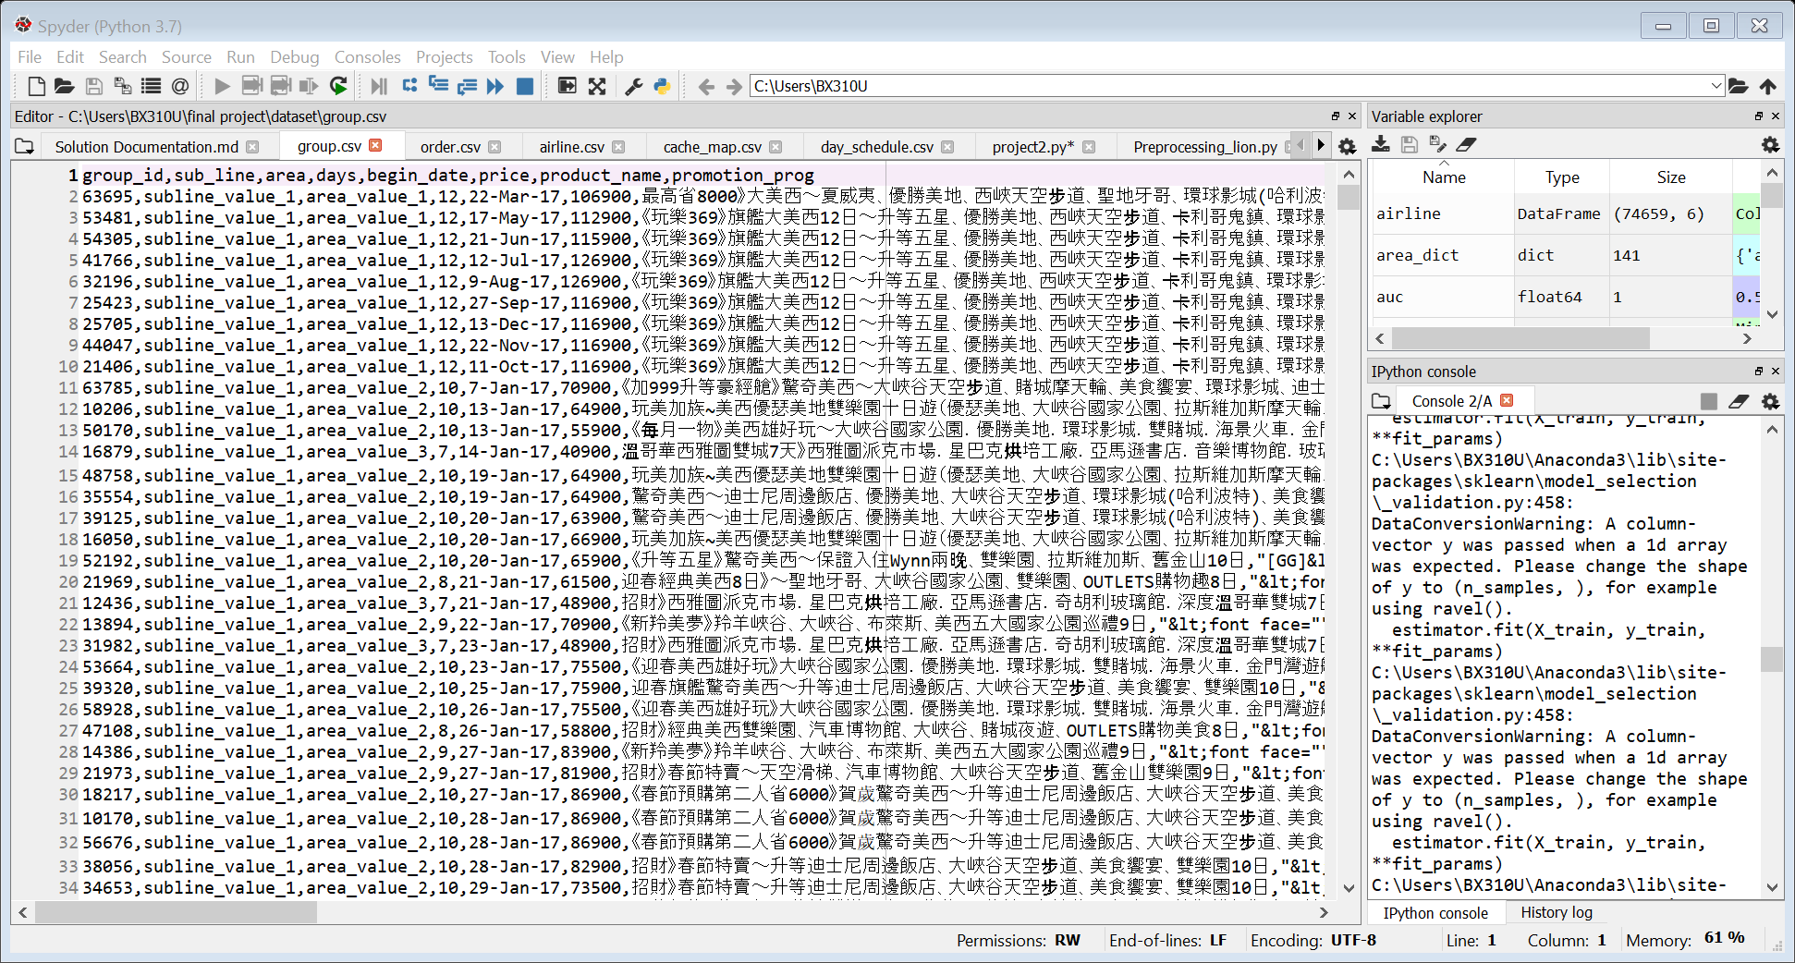
Group.csv

Slide 9
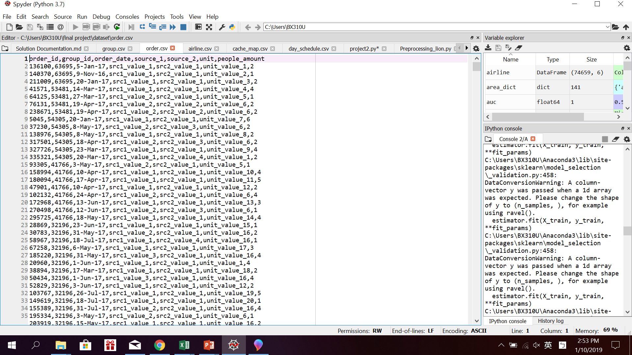
Order.csv

Slide 10
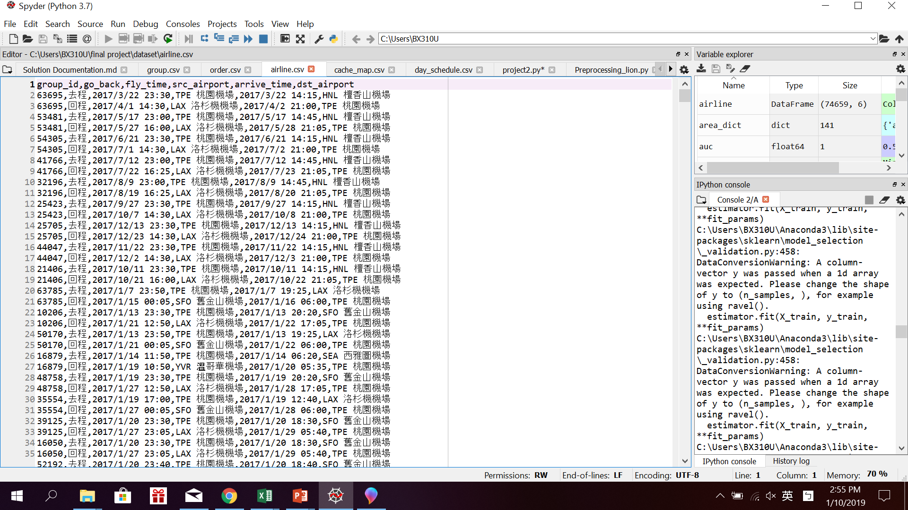
Airline.csv

Slide 11
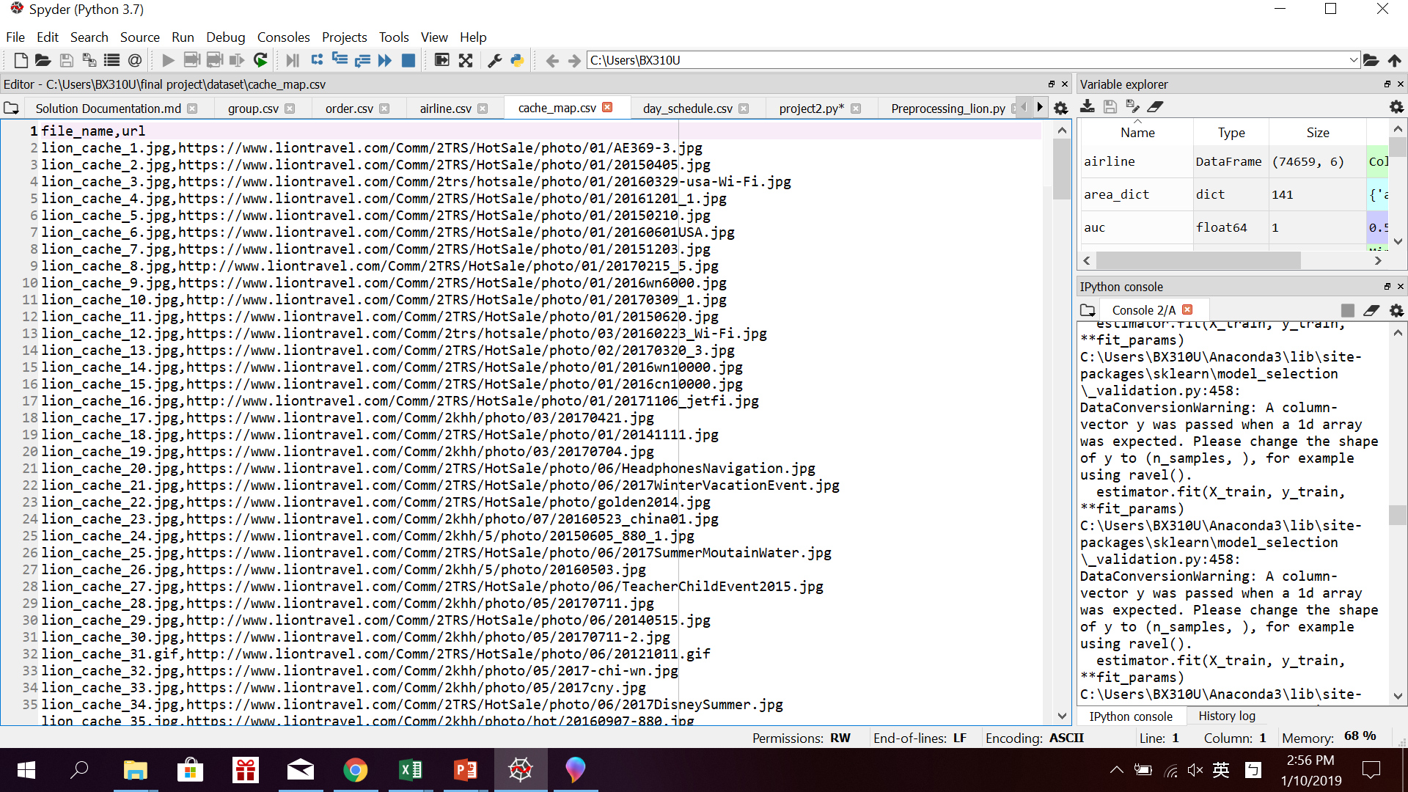
Cashe_map.csv

Slide 12
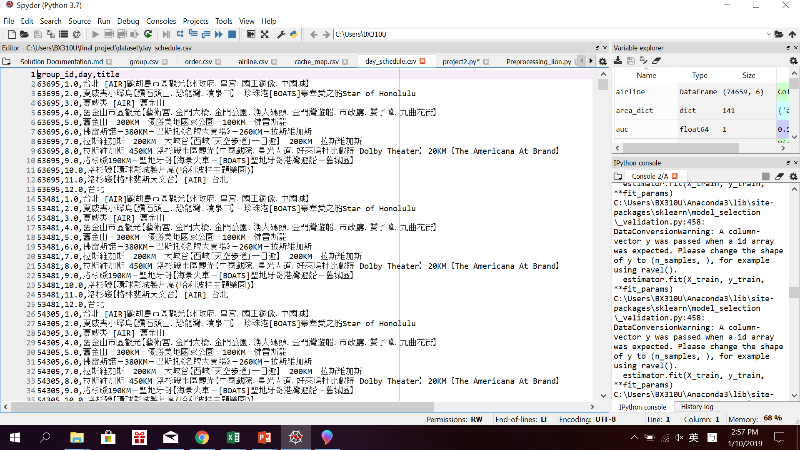
Day_schedule.csv

Slide 13
Input Preprocessing
Missing Data?
What are useful features?
Evaluate
Notes:
將

Slide 14
Travel Motivation
Free time
Have enough money
Convenient transportation options
social atmosphere that encourages tourism
Source : https://wiki.mbalib.com/zh-tw/%E6%97%85%E6%B8%B8%E5%8A%A8%E6%9C%BA

Slide 15
Feature
How many people?
Days between order and depart?
Return date is holidaty?
Order date? Holiday? Month?
Expensive? Discount? High cp value?
Notes:
將

Slide 16
Feature selection
Order date month
People amount
days
cp
price
Begin date month
discount
Fly count
Order date dayofweek
MORE...
Notes:
將

Slide 17
Null model
How to build a null model: always return the most popular Category
Most of orders would be cancled in the end depend the data set:
A model that labels all order as not deal => get 0.5 AUC

Slide 18
Modeling
Logistic Regression
Random Forest

Slide 19
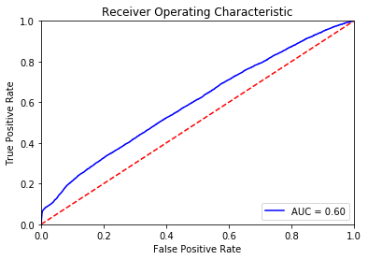
Logistic Regression
Poor AUC : 0.59
Null model : 0.5
Not good enough!
Thought:
There are large number of categorical features/variables.
Transformations for non-linear features do not do well.

Slide 20
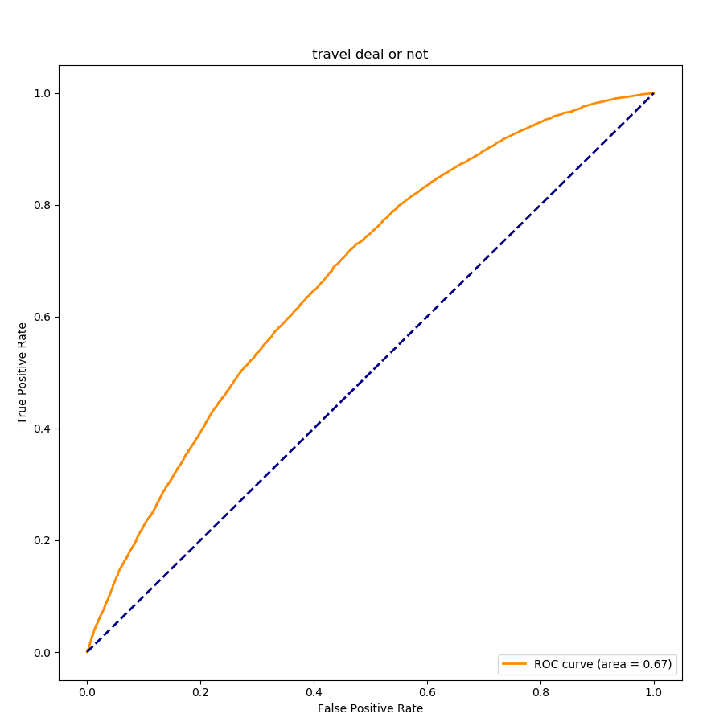
Random Forest
n_estimators = 200
AUC : 0.67
Null model : 0.5
Perform evaluation : Cross-validation

Slide 21

Improvement
In the begining, AUC is around 0.61,
after we put the source to be a feature,
and changed it into dummy variables, AUC was up to 0.67!

Slide 22
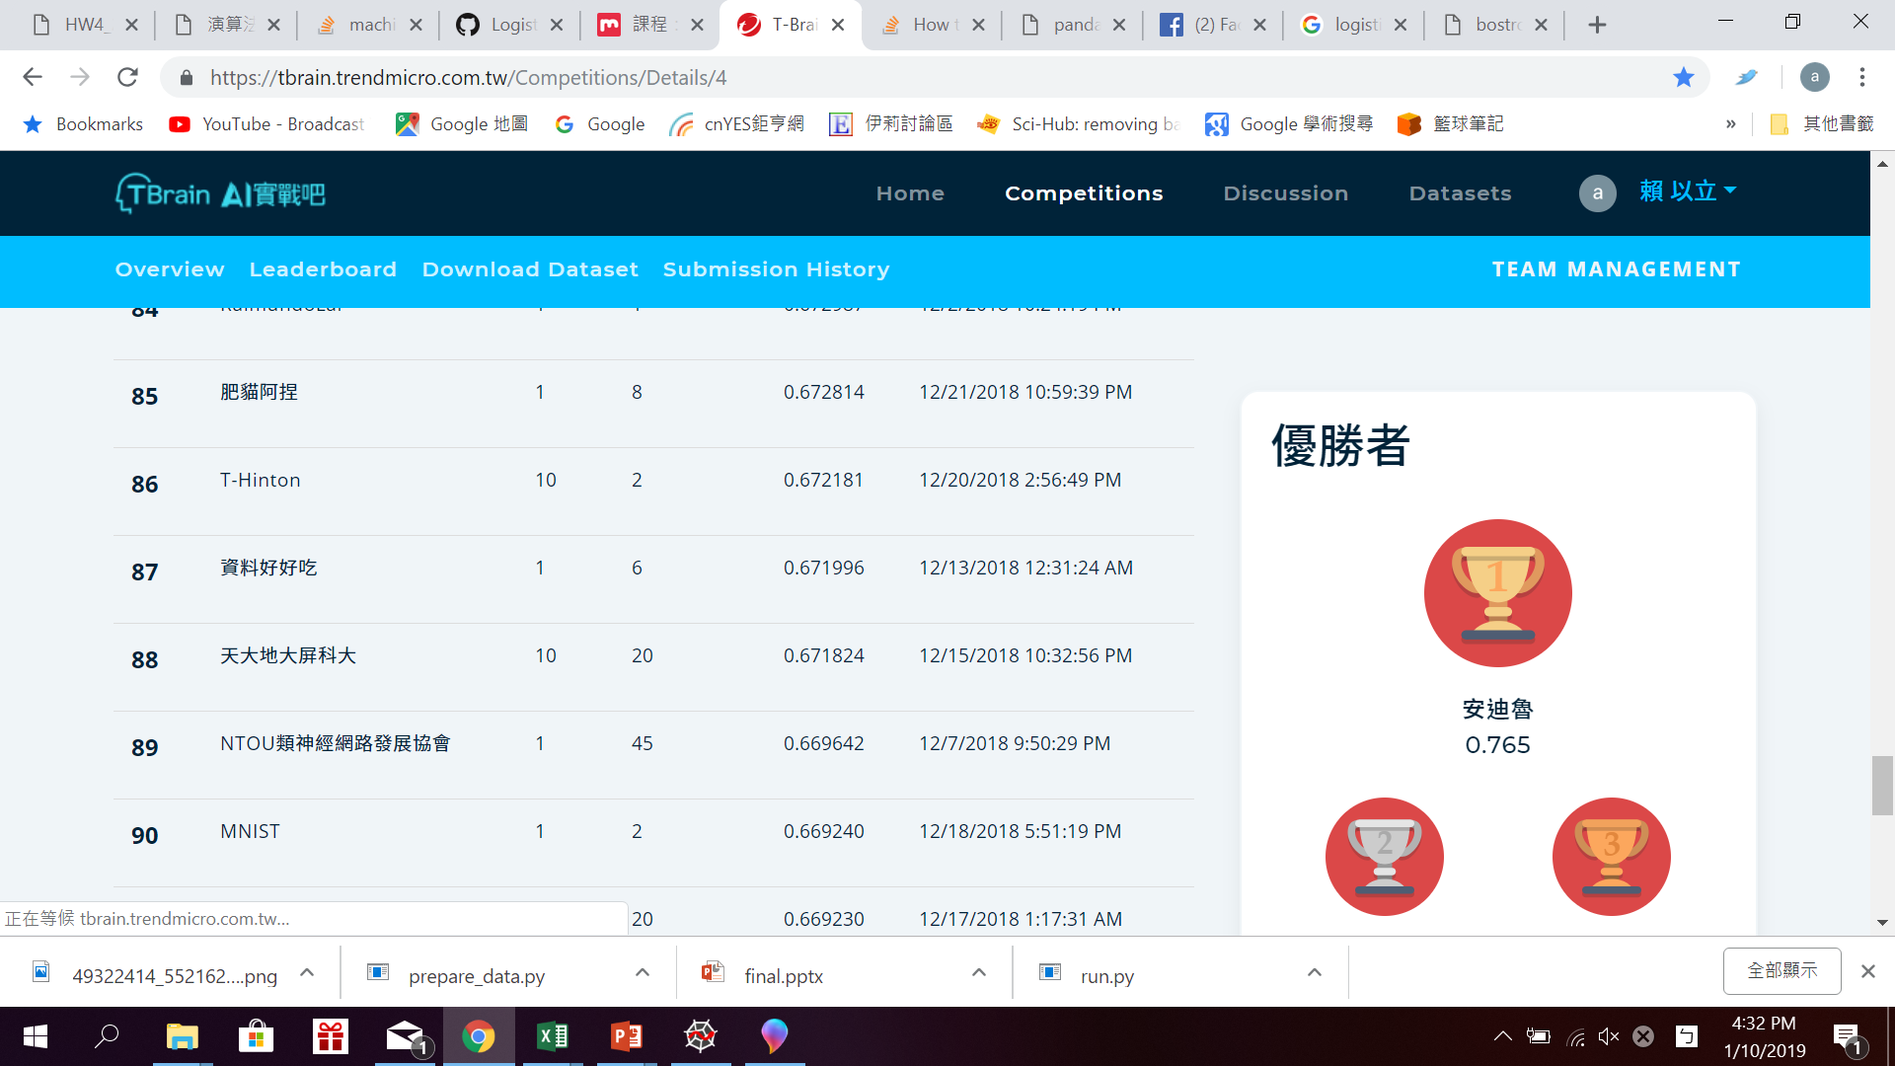
Result
AUC : 0.67 (the competition No1 : 0.76)
Accuracy : 0.7476356509651102

Slide 23


Challenge
What is useful feature?
How to produce? Try!
Model choose
Logistic Regression?
KNN?
Random Forest?
(the No.1 use LGB model)

